Slide 1
Simulation and Modeling
CSE4131_CSE4132

Slide 2
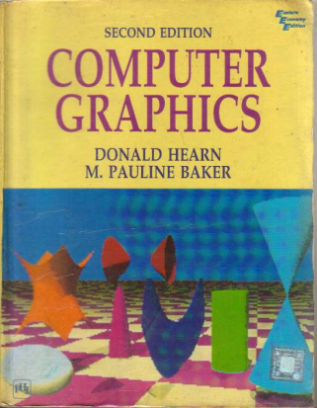
Reference Book
Computer Graphics (2nd Edition)
D. HEARN
M. P. BAKER

Slide 3
SPLINE
Spline
Interpolation
Cubic Spline Interpolation Method
Natural Cubic Splines
Hermit Spline
Cardinal Splines
Kochanek-Bartels Splines
Approximation
Bezier curves and surfaces
B-spline curves and surfaces
Beta-Splines
Rational Splines

Slide 4
SPLINE
Spline
Interpolation
Cubic Spline Interpolation Method
Natural Cubic Splines
Hermit Spline
Cardinal Splines
Kochanek-Bartels Splines
Approximation
Bezier curves and surfaces
B-spline curves and surfaces
Beta-Splines
Rational Splines

Slide 5

Bezier curves and surfaces
Last class ⇨ Bezier Spline + cubic Bezier Spline
Now we need to know about Bezier Surface
Bezier Surface
Two sets of orthogonal Bezier curves can be used to design an object surface by specifying by an input mesh of control points.
The parametric vector function for the Bezier surface is formed as the Cartesian product of Bezier blending functions:
Eq. 10.53
with p_{j,k} specifying the location of the (m + 1) by (n + I ) control points.

Slide 6
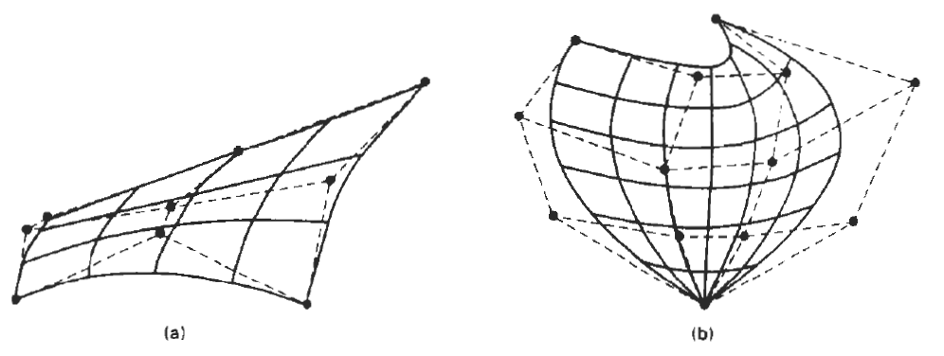
Bezier Surface
Figure 10-39 illustrates two Bezier surface plots.
The control points are connected by dashed lines, and
the solid lines show curves of constant u and constant v.
Each curve of constant u is plotted by varying v over the interval from 0 to 1, with u fixed at one of the values in this unit interval.
Curves of constant v are plotted similarly

Slide 7
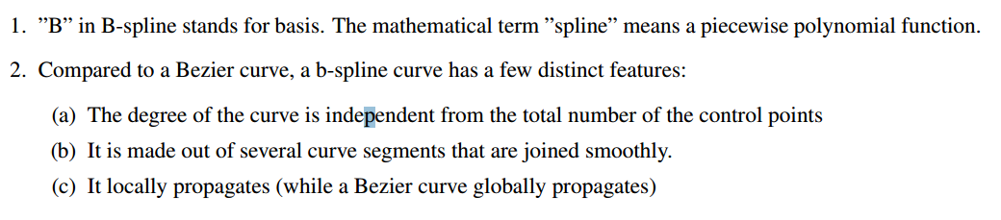
B- Spline Curves

Slide 8
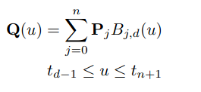
B- Spline Curves
A b-spline curve is mathematically defined as:
d-1is the degree of the polynomial, for example: d= 2 is linear,
d= 3 is quadratic,
d= 4 is cubic, etc. The value of n must be larger or equal to d. t_{j} is a knot value.
* d is the number of the control points that control a segment
Control points
Total points=n+1

Slide 9
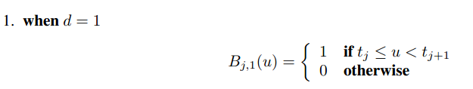
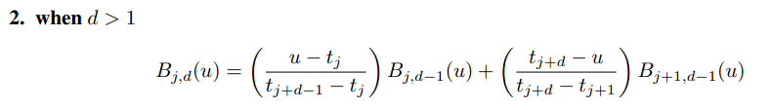
B-Spline’s Basis Functions
There exist two mathematical definition of B-Spline blending function:
New terms: Knot Vector t=(t₀, t₁, t₂, t₃,…)

Slide 10



Knot Vector
The number of the knot values (or the size of the knot vector) is determine by:

Slide 11
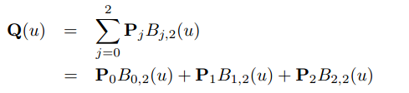
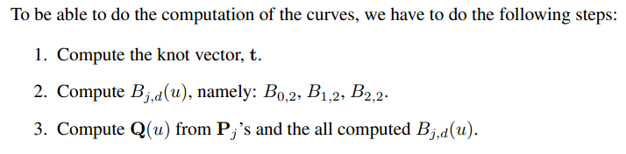
Linear Uniform B-spline Curves
In b-spline, linear means that d= 2. Suppose we have 3 control points, implying n= 2.
Hence, we can write the linear uniform b-spline curves as:

Slide 12


Computing the knot vector
By considering
n= 2 and d= 2, we can have m= n + d + 1 = 5
Since it is a uniform b-spline curve and we can assume k= 1, then:

Slide 13

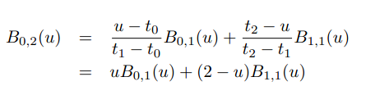
Computing B_{j,d}(u)
Here, j=0 and d=2

Slide 14
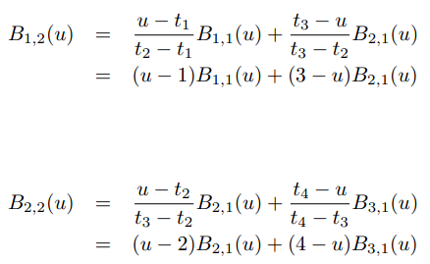
Computing B_{j,d}(u)
we need the definition of B_{0,1}(u); B_{1,1}(u); B_{2,1}(u), and B_{3,1}(u)

Slide 15





case j=0
case j=1
case j=2
case j=3

Slide 16

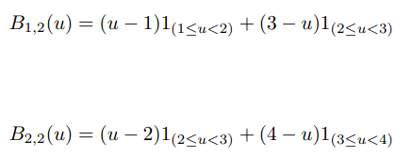
Similarly:

Slide 17
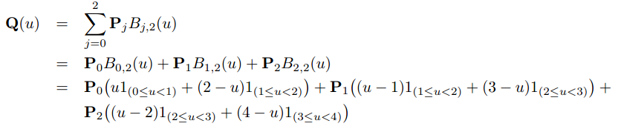
B- Spline
Finally

Slide 18

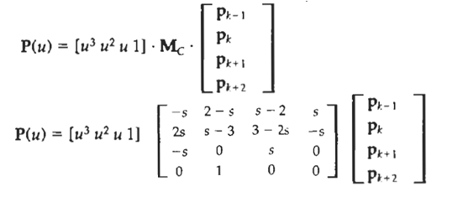
CONVERSION BETWEEN SPLINE REPRESENTATIONS
Hermite Spline:
Cardinal Splines:

Slide 19

CONVERSION BETWEEN SPLINE REPRESENTATIONS
Sometimes it is desirable to be able to switch from one spline representation to another.
Suppose we have a spline description of an object that can be expressed with the following matrix product:
where
M_{spline1} is the matrix characterizing the spline representation, and
M_{geom1} the column matrix of geometric constraints (for example, control-point coordinates).

Slide 20


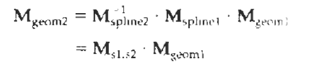

CONVERSION BETWEEN SPLINE REPRESENTATIONS
We are willing to transfer in another form

Slide 21
3D Object Representation
Two broad categories:
Boundary representations (B-reps)
Space-partitioning

Slide 22
CONSTRUCTIVE SOLID-GEOMETRY METHOD
Constructive Solid Geometry methods - CSG method
Technique for solid modeling is to combine the volumes occupied by overlapping three-dimensional objects using set operations.
… creates a new volume by applying the union, intersection, or difference operation to two specified volumes.

Slide 23
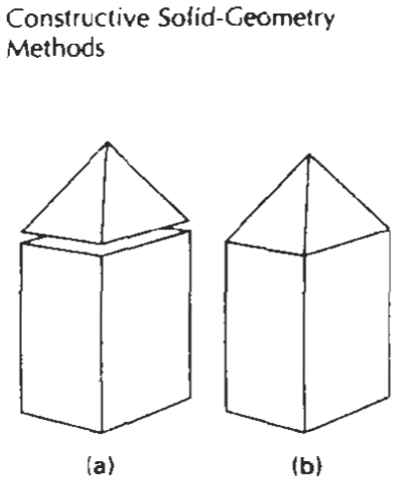
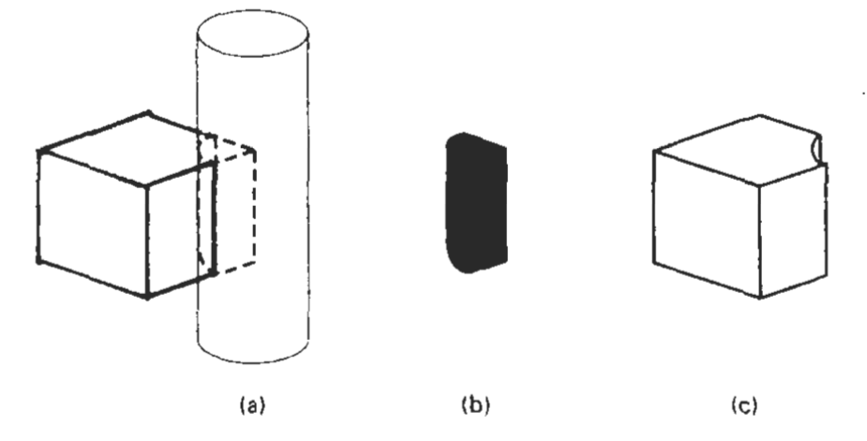
CONSTRUCTIVE SOLID-GEOMETRY METHODS
A CSG application starts with an initial set of three dimensional objects (primitives), such as blocks, pyramids, cylinders, cones, spheres, and closed
spline surfaces

Slide 24
FRACTAL
All the object representations …Euclidean-geometry methods;
that is, object shapes were described with equations.
These methods are adequate for describing manufactured objects:
Those that have smooth surfaces and regular shapes.
But natural objects, such as mountains and clouds, have irregular or fragmented features, and Euclidean methods do not realistically model these objects.
Natural objects can be realistically described with fractal-geometry methods, where procedures rather than equations are used to model objects.

Slide 25
FRACTAL
A fractal object has two basic characteristics:
infinite detail at every point and
a certain self similarity between the object parts and the overall features of the object.
We can describe the amount of variation in the object detail with a number called the fractal dimension.
Unlike the Euclidean dimension, this number is not necessarily an integer. The fractal dimension of an object is sometimes referred to as the fractional dimension, which is the basis for the name "fractal“.

Slide 26

Fractal-Generation Procedures
A fractal object is generated by repeatedly applying a specified transformation function to points within a region of space.
If P₀ = (x₀, y₀,z₀) is a selected initial point, each iteration of a transformation function F generates successive levels of detail with the calculations
In general, the transformation function can be applied to a specified point set, or we could apply the transformation function to an initial set of primitives,
such as straight lines, curves, color areas, surfaces, and solid objects.

Slide 27
Classification of Fractals
Self similar
Self-affine
Invariant fractal sets
Self similar
Self similar fractals have parts that are scaled-down versions of the entire object.
Starting with an initial shape, we construct the object subparts by apply a scaling parameter s to the overall shape.
If we apply random variations to the scaled-down subparts, the fractal is said to be statistically self similar. E.g commonly used to model trees, bushes, and other plants.

Slide 28
Classification of Fractals
Self-affine
Self-affine fractals have parts that are formed with different scaling parameters, s_{x} s_{y}, s_{z}, in different coordinate directions.
And we can also include random variations to obtain statistically self-affine fractals.
Terrain (land), water, and clouds are typically modeled with statistically self-affine fractal construction methods
Invariant fractal sets
Invariant fractal sets are formed with nonlinear transformations.
This class of fractals includes self-squaring fractals, such as the Mandelbrot set, which are formed with squaring functions in complex space; and self inverse fractals, formed with inversion procedures.

Slide 29
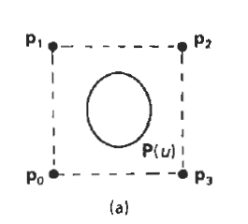
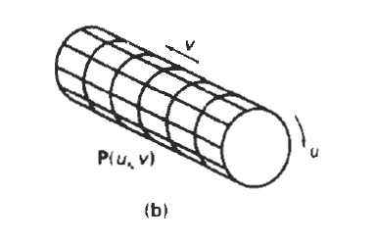
Sweep Representation
Sweep representations are useful for constructing three-dimensional objects that possess translational, rotational, or other symmetries.
We can represent such objects by specifying a two dimensional shape and a sweep that moves the shape through a region of space.
A set of two-dimensional primitives, such as circles and rectangles, can be provided for sweep representations as menu options.
Other methods for obtaining two-dimensional figures include closed spline curve constructions and cross-sectional slices of solid objects.

Slide 30
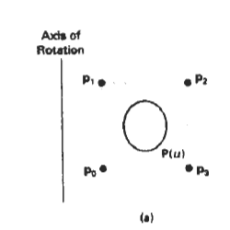
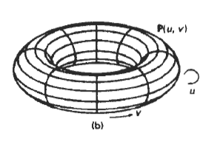
Sweep Representation
Constructing a solid with a rotational sweep Rotating the control points of the periodic spline curve in (a) about the given rotation axis generates the solid shown in (b), whose surface can be described with point function P(u,v).

